Slide 1

Reducing Customer Churn at Meridian Retail Group

Slide 2
Presented
by
Bunah Victor Makwin
For the award of Data Science Certification
by
Pora Academy
30/10/2026

Slide 3

Business Problem
Meridian Retail Group, a mid-sized multi-channel retailer, faces rising customer churn. Retaining customers is critical for profitability, as acquiring new customers is significantly more expensive than keeping existing ones.
Effects includes:
Rising churn rate in retail/e‑commerce.
Customer inactivity and dissatisfaction threaten revenue.
Business impact: lost lifetime value, higher acquisition costs.

Slide 4
Project Objectives
This research has 4 objectives in addressing the business challenges
Diagnose drivers of churn.
Build predictive models to identify at‑risk customers.
Recommend actionable retention strategies.
Deploy API for real‑time scoring.

Slide 5
Dataset
The dataset used for analyzing and building a business solution is generated from Meridian Retails Groups customers database, including datasets like:
Customers (demographics, membership tier, referral source)
Orders: transactional data (RFM: Recency, Frequency, & Monetary)
Support Tickets: Satisfaction scores, resolution times.
Products: different types of product purchased.
Order Items

Slide 6

Data Quality Issues
Missing values in customer demographics
Inconsistent data formats in orders.
Outliers in monetary spend (extreme high value orders).
Support ticket text unstructured.

Slide 7
Exploratory Data Analysis (EDA) findings
Inactivity >365 days triples churn risk.
Low frequency strongly linked to churn.
Poor support experience increases churn.
Platinum members churn least; Silver most vulnerable.
Online customers churn more than mobile app users.

Slide 8
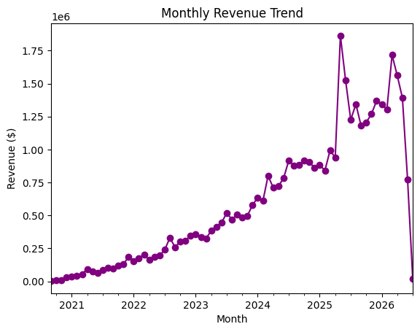
EDA Visuals

Slide 9
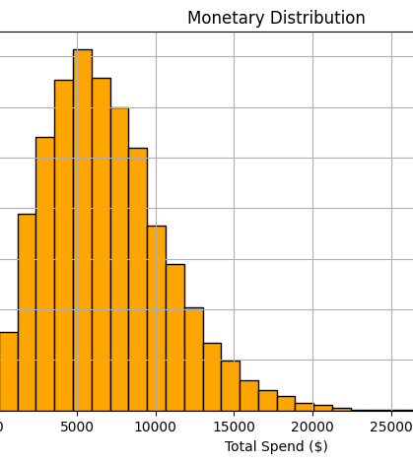
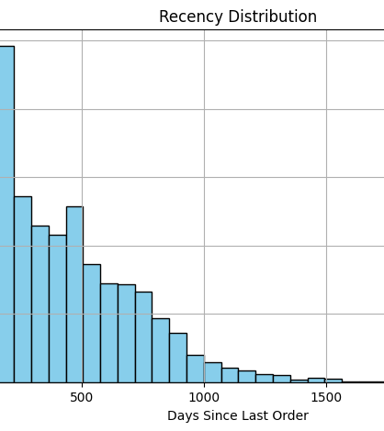

Slide 10
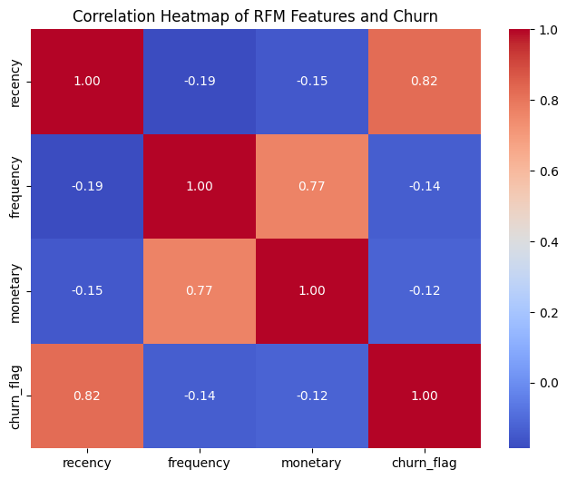

Slide 11
Machine Learning (ML) Approach
Feature engineering: Recency, Frequency , Monetary & support features
Models Tested: Logistic Regression, Decision Tree, Random Forest & Gradient Boosting.
Train/Test split with stratification
Evaluation metrics : Accuracy, Precision, Recall, F1 & ROC-AUC.

Slide 12
Model Comparison
Logistic Regression: ~98% accuracy.
Decision Tree: 100% accuracy (likely overfitting).
Random Forest: ~99.8% accuracy.
Gradient Boosting: ~99.9% accuracy.
Gradient Boosting selected as final model (balanced performance + interpretability).

Slide 13
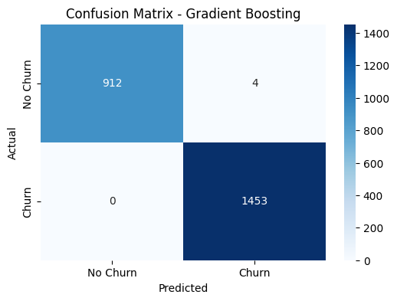

Slide 14
Final Model Performance
Accuracy: 99.9%
Precision: 1.00
Recall: 1.00
F1 Score: 1.00
Strong ability to identify churned customers.
ROC-AUC: ~0.91

Slide 15
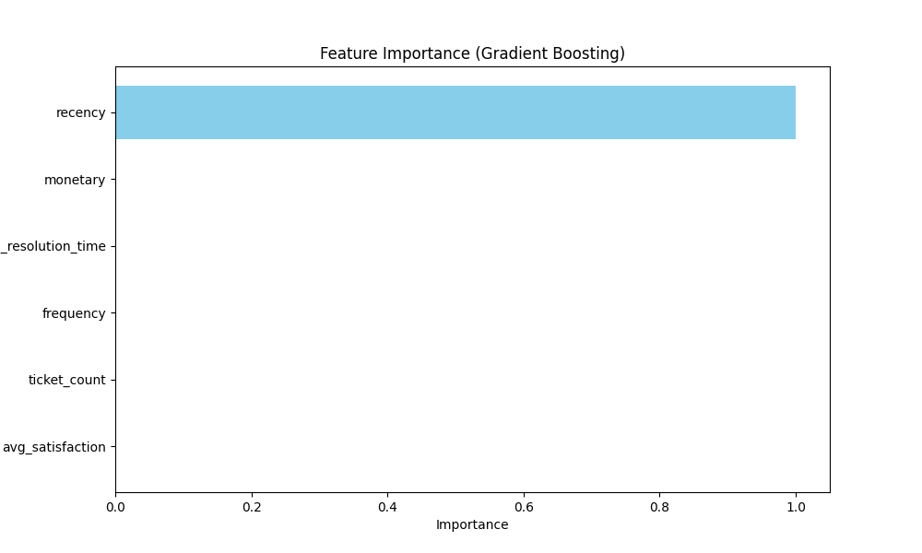
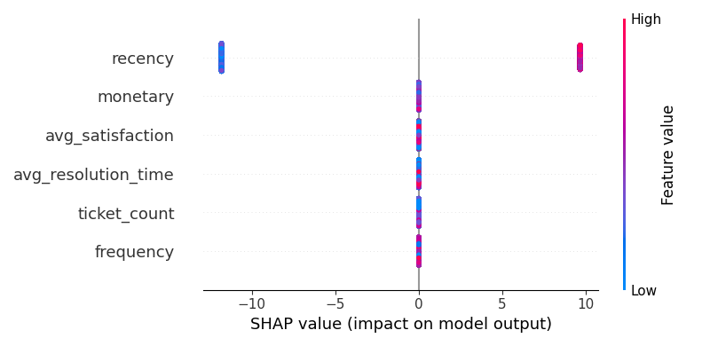

Slide 16
Model Insights
Recency is the dominant churn driver.
Frequency and monetary value reduce churn risk.
Support satisfaction and resolution time critical.
SHAP plots confirm inactivity + poor support push churn risk.

Slide 17

Business Recommendations
Retention campaigns for inactive customers.
Loyalty rewards for frequent buyers.
Improve support resolution times and satisfaction.
Enhance online shopping experience.
Personalized marketing by channel.

Slide 18
Limitations
Limited text analysis of support tickets.
Model performance may vary in production.
Requires continuous retraining with fresh data.
Limited feature scope (no external factors). E.g. competitors

Slide 19
Conclusion
This project demonstrates how data science can diagnose churn drivers and predict at-risk customers. By combining business insights with machine learning, Meridian Retail Group can reduce churn, improve customer satisfaction, and increase profitability. The deployed API provides a practical tool for integrating predictive analytics into business operations.

